Slide 1
Code demo
Sami Jones
14009730

Slide 2
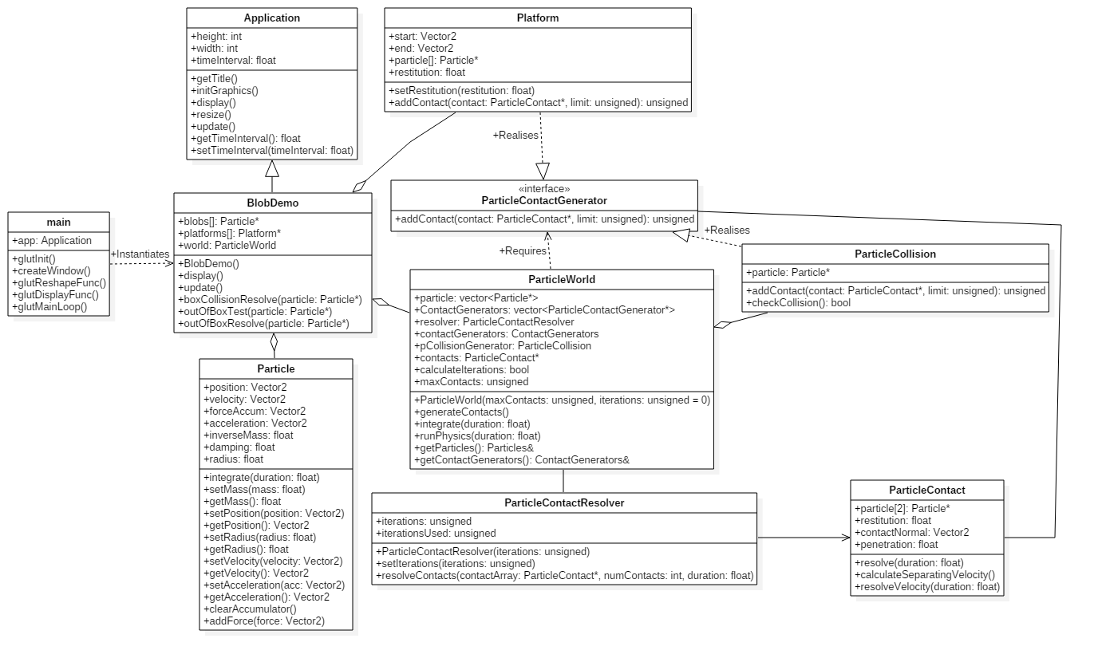

Slide 3
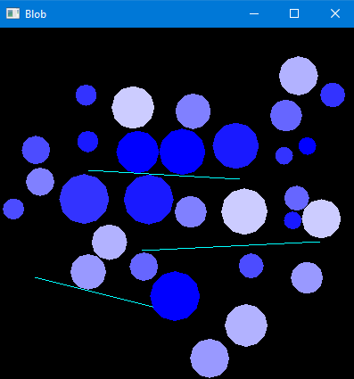
Screenshots

Slide 4
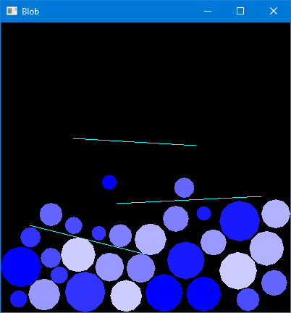
Screenshots

Slide 5
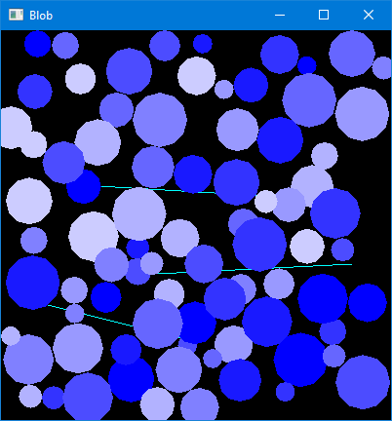
More particles

Slide 6
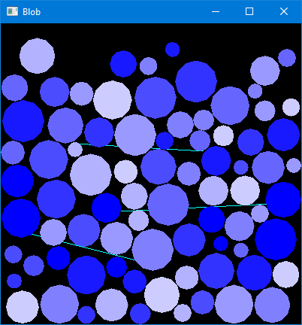
More particles

Slide 7
Collision detection and resolution
Brute force approach at the moment
For each sphere
For each other sphere
If radius1 + radius2 < distance between sphere mid-points, objects are touching
Calculate normal at the point of contact
Calculate x and y components of both spheres’ velocities using normal
Calculate new velocities for spheres by plugging current velocities and masses into elastic collision formula

